Slide 1
Making Scientific Figures Great Again: Essential TikZ Skills Every Thesis Deserves
Ashutosh Mukherjee

Slide 2
Some Background
Doctoral Researcher at Institut für Technische Mechanik (ITM) – Dynamik & Mechatronik
Masters in Mechanical Engineering from RWTH Aachen
Area of Research: Energy Efficient Locomotion in Bipedal Robots
Average TikZ Enjoyer

Slide 3
Target-Audience
Latex is used as a standard tool in your workflow for documentation
Looking to switch from Word to Latex
Basic idea about Latex syntax
Generation of vector graphics is a standard part of your workflow
Looking to switch to vector graphics for your presentations
Bonus: frustrated with current solution for vector graphics generation

Slide 4
What this talk entails?
TikZ: a medium of drawing vector graphics
Why Vector Graphics?
What about other graphical softwares
Illustration of some useful packages with the help of some self-made diagrams
Open Discussion
Too much detail on syntax not presented

Slide 5
Why Vector Graphics?

Slide 6
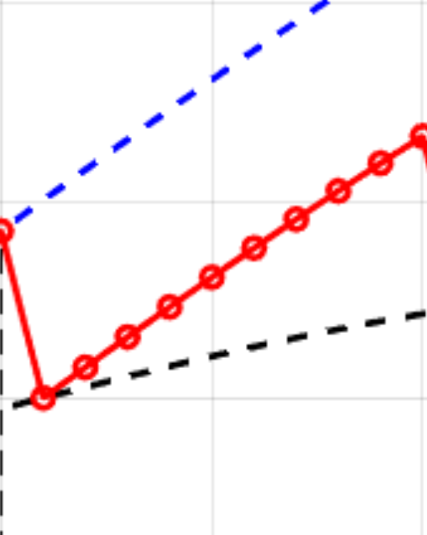
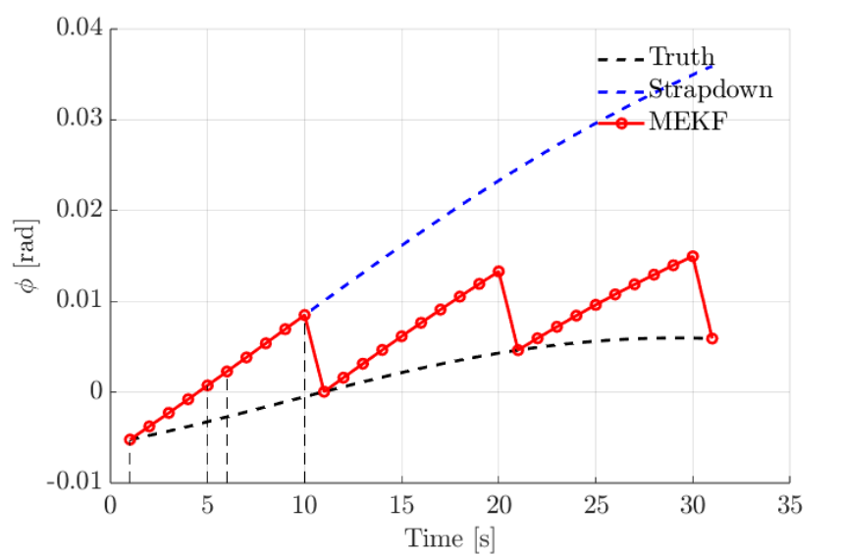
Raster Graphic

Slide 7
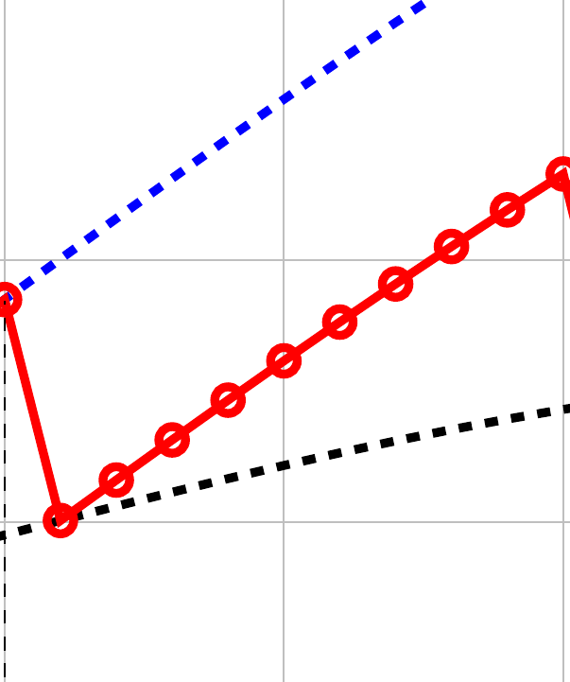
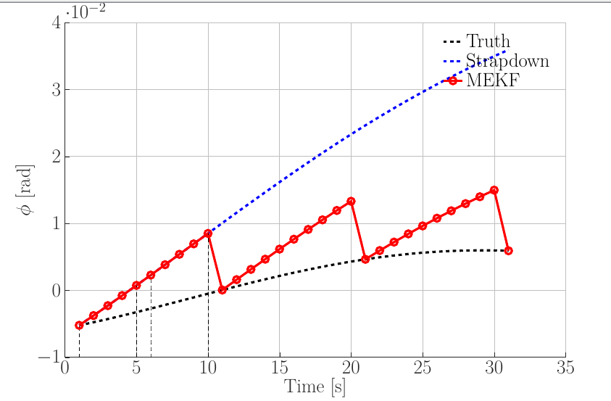
Vector Graphic
Source
./illustrationScripts/vector_raster/vectorRaster_standalone.tex

Slide 8
A Simple Example

Slide 9
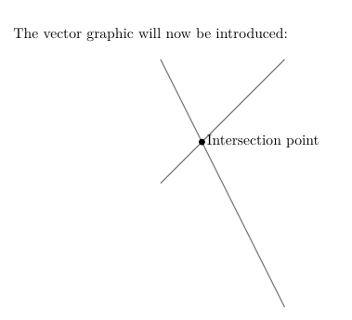
\documentclass{article}
\usepackage{tikz}
\begin{document}
The vector graphic will now be introduced:
\begin{figure}[h!]
\centering
\begin{tikzpicture}
\draw[gray, thick] (-1,2) -- (2,-4);
\draw[gray, thick] (-1,-1) -- (2,2);
\filldraw[black] (0,0) circle (2pt) node[anchor=west]{Intersection point};
\end{tikzpicture}
\end{figure}
\end{document}
Source
./illustrationScripts/simpleEx/simpleEx_1.tex

Slide 10
What about code modularity?

Slide 11
simpleEx_2.tex:
\documentclass{article}
\usepackage{tikz}
\begin{document}
The vector graphic will now be introduced:
\begin{figure}[h!]
\centering
\input{figSource}
\end{figure}
\end{document}
Graphic Source Code
figSource.tex:
\begin{tikzpicture}
\draw[gray, thick] (-1,2) -- (2,-4);
\draw[gray, thick] (-1,-1) -- (2,2);
\filldraw[black] (0,0) circle (2pt) node[anchor=west]{Intersection point};
\end{tikzpicture}
Source
./illustrationScripts/simpleEx/simpleEx_2.tex

Slide 12
What about other graphical softwares?

Slide 13
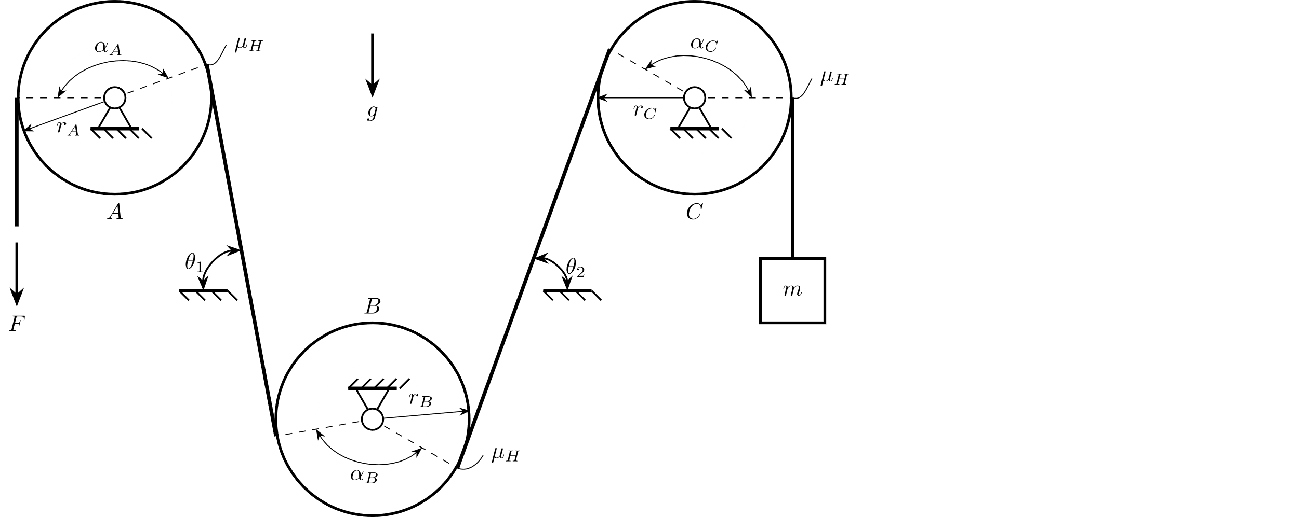
Ease of Integration
TikZ: No additional integration tools required
Others: special packages for LaTeX integration (eg: Inkscape Integration with LaTeX (Stack Exchange)
Source
./illustrationScripts/TikZ_vs_Inkscape/pulleyExample_standalone.tex

Slide 14
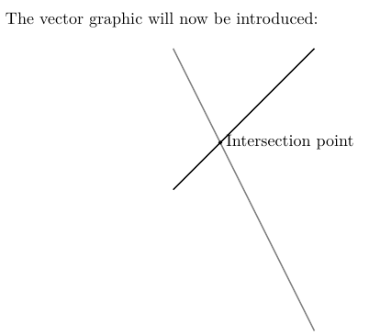
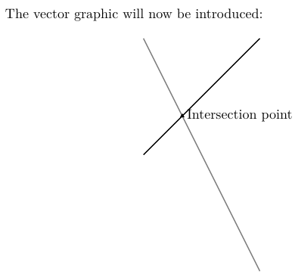
Human-readable version control diffs
Older Version
Newer Version

Slide 15
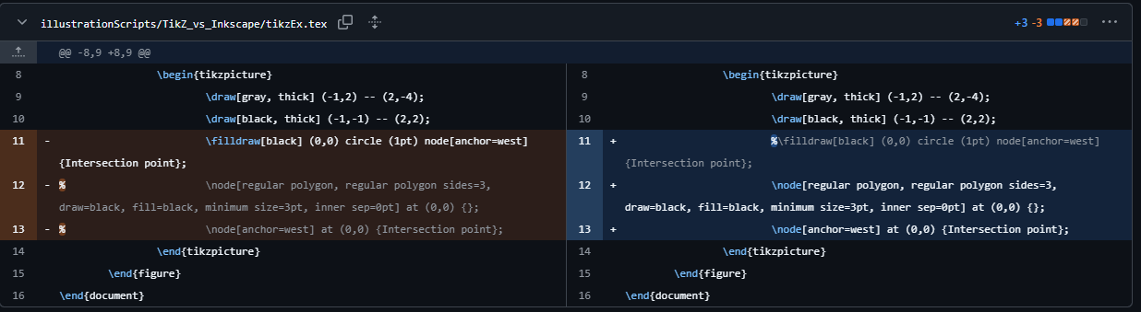
Diff with TikZ

Slide 16
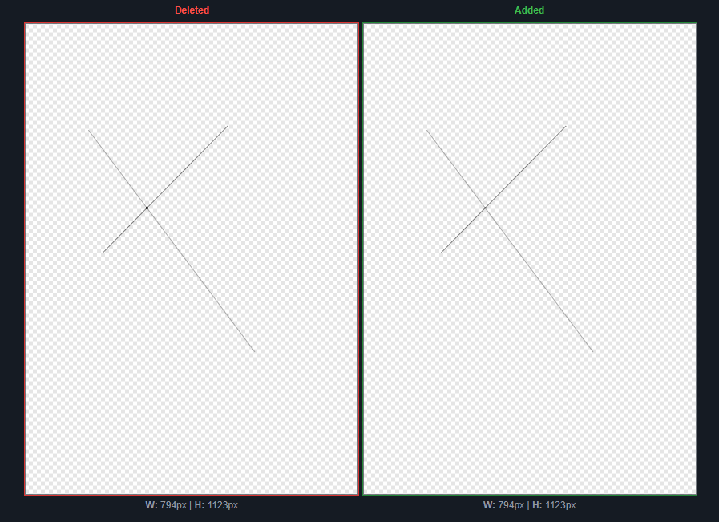
Diff with Inkscape

Slide 17
The building blocks of any good TikZ graphic: Nodes
An introduction with the help of Block Digrams

Slide 18
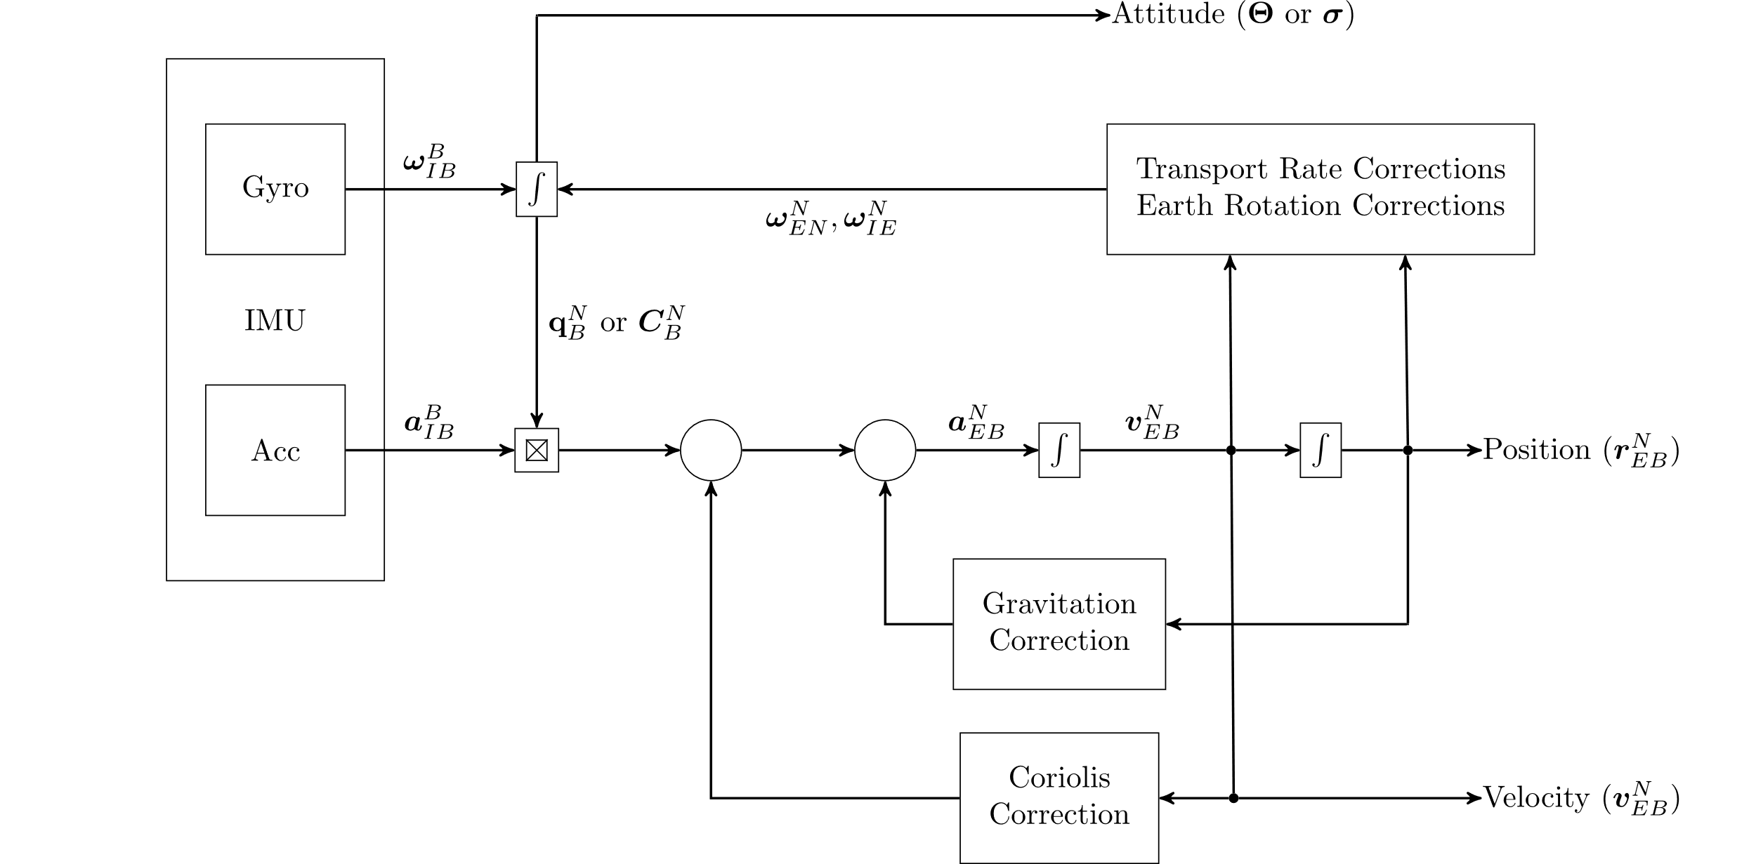

Slide 19

TikZ styles preamble (local to each tikzpicture graphic)
\tikzstyle{imu} = [draw, rectangle, minimum height=6cm, minimum width=2.5cm]
\tikzstyle{block} = [draw, rectangle, minimum height=1.5cm, minimum width=1.6cm]
\tikzstyle{blockM} = [draw, rectangle, minimum height=0.5cm, minimum width=0.5cm]
\tikzstyle{blockS} = [draw, rectangle, minimum height=0.5mm, minimum width=0.5mm]
\begin{tikzpicture}[auto, node distance=3cm, >=stealth‘]
\node[imu] (imu) {IMU}; % IMU Block
\end{tikzpicture}
Local Name of node inside tikzpicture environment
\node[nodeType] (nodeName) {Text inside Node};
Usually defined in TikZ preamble

Slide 20

\tikzstyle{imu} = [draw, rectangle, minimum height=6cm, minimum width=2.5cm]
\tikzstyle{block} = [draw, rectangle, minimum height=1.5cm, minimum width=1.6cm]
\tikzstyle{blockM} = [draw, rectangle, minimum height=0.5cm, minimum width=0.5cm]
\tikzstyle{blockS} = [draw, rectangle, minimum height=0.5mm, minimum width=0.5mm]
\begin{tikzpicture}[auto, node distance=3cm, >=stealth‘]
\node[imu] (imu) {IMU}; % IMU Block
\node[block, above of = imu, node distance = 1.5cm] (gyro) {Gyro}; % Gyro Block
\end{tikzpicture}
\node[nodeType, nodePosition] (nodeName) {Text inside Node};
Absolute or relative (wrt other nodes) position

Slide 21

\tikzstyle{imu} = [draw, rectangle, minimum height=6cm, minimum width=2.5cm]
\tikzstyle{block} = [draw, rectangle, minimum height=1.5cm, minimum width=1.6cm]
\tikzstyle{blockM} = [draw, rectangle, minimum height=0.5cm, minimum width=0.5cm]
\tikzstyle{blockS} = [draw, rectangle, minimum height=0.5mm, minimum width=0.5mm]
\begin{tikzpicture}[auto, node distance=3cm, >=stealth‘]
\node[imu] (imu) {IMU}; % IMU Block
\node[block, above of = imu, node distance = 1.5cm] (gyro) {Gyro}; % Gyro Block
\node[block, below of = imu, node distance = 1.5cm] (acc) {Acc}; % Acc Block
\end{tikzpicture}

Slide 22

\tikzstyle{imu} = [draw, rectangle, minimum height=6cm, minimum width=2.5cm]
\tikzstyle{block} = [draw, rectangle, minimum height=1.5cm, minimum width=1.6cm]
\tikzstyle{blockM} = [draw, rectangle, minimum height=0.5cm, minimum width=0.5cm]
\tikzstyle{blockS} = [draw, rectangle, minimum height=0.5mm, minimum width=0.5mm]
\begin{tikzpicture}[auto, node distance=3cm, >=stealth‘]
\node[imu] (imu) {IMU}; % IMU Block
\node[block, above of = imu, node distance = 1.5cm] (gyro) {Gyro}; % Gyro Block
\node[block, below of = imu, node distance = 1.5cm] (acc) {Acc}; % Acc Block
\node[blockS, right of = gyro] (int1) {$\int$}; % Integrator Block
% Product block
\node[blockM, right of = acc] (product) {$$};
\node[blockS, right of = acc] (product1) {$$};
\coordinate (c1) at (product1.north west);
\coordinate (c2) at (product1.north east);
\coordinate (c3) at (product1.south west);
\coordinate (c4) at (product1.south east);
\draw (c1) -- (c4);
\draw (c2) -- (c3);
\end{tikzpicture}

Slide 23

\tikzstyle{imu} = [draw, rectangle, minimum height=6cm, minimum width=2.5cm]
\tikzstyle{block} = [draw, rectangle, minimum height=1.5cm, minimum width=1.6cm]
\tikzstyle{blockM} = [draw, rectangle, minimum height=0.5cm, minimum width=0.5cm]
\tikzstyle{blockS} = [draw, rectangle, minimum height=0.5mm, minimum width=0.5mm]
\begin{tikzpicture}[auto, node distance=3cm, >=stealth‘]
\node[imu] (imu) {IMU}; % IMU Block
\node[block, above of = imu, node distance = 1.5cm] (gyro) {Gyro}; % Gyro Block
\node[block, below of = imu, node distance = 1.5cm] (acc) {Acc}; % Acc Block
\node[blockS, right of = gyro] (int1) {$\int$}; % Integrator Block
% Product block
\node[blockM, right of = acc] (product) {$$};
\node[blockS, right of = acc] (product1) {$$};
\coordinate (c1) at (product1.north west);
\coordinate (c2) at (product1.north east);
\coordinate (c3) at (product1.south west);
\coordinate (c4) at (product1.south east);
\draw (c1) -- (c4);
\draw (c2) -- (c3);
%% Connections
\draw[connector](gyro) -- node{$\bm{\omega}^B_{IB}$} (int1);
\draw[connector](acc) -- node{$\bm{a}^B_{IB}$} (product);
\end{tikzpicture}

Slide 24
\usepackage{tikz}
\usepackage{arrows}
Source
./illustrationScripts/FavExamples/strapdown_standalone.tex

Slide 25
Making plots in three-dimensional space
tikz-3dplot

Slide 26
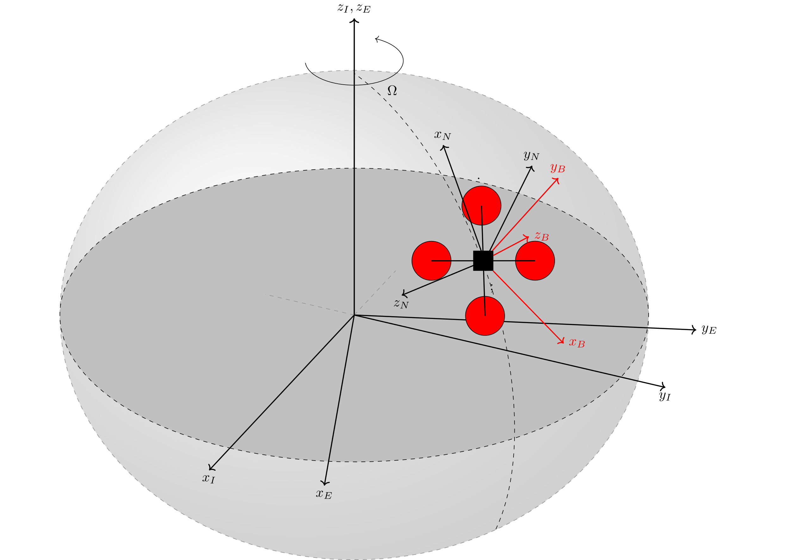

Slide 27

\tdplotsetmaincoords{60}{115} % controls the orientation of the main coordinate system (Inertial Frame)
\pgfplotsset{compat=newest}
\begin{tikzpicture}[tdplot_main_coords, scale = 2.5]
% Create a point (P)
\coordinate (P) at (3,3,3);
% Origin
\coordinate (O) at (0,0,0);
% Define the ellipsoid parameters
\def\rx{3cm} % x-radius
\def\ry{2.5cm} % y-radius
% Draw shaded circle
\shade[ball color = lightgray,
opacity = 0.25] (0,0,0) ellipse ({\rx} and {\ry});
\end{tikzpicture}
\tdplotsetmaincoords{rot. About X}{rot. About Z}

Slide 28
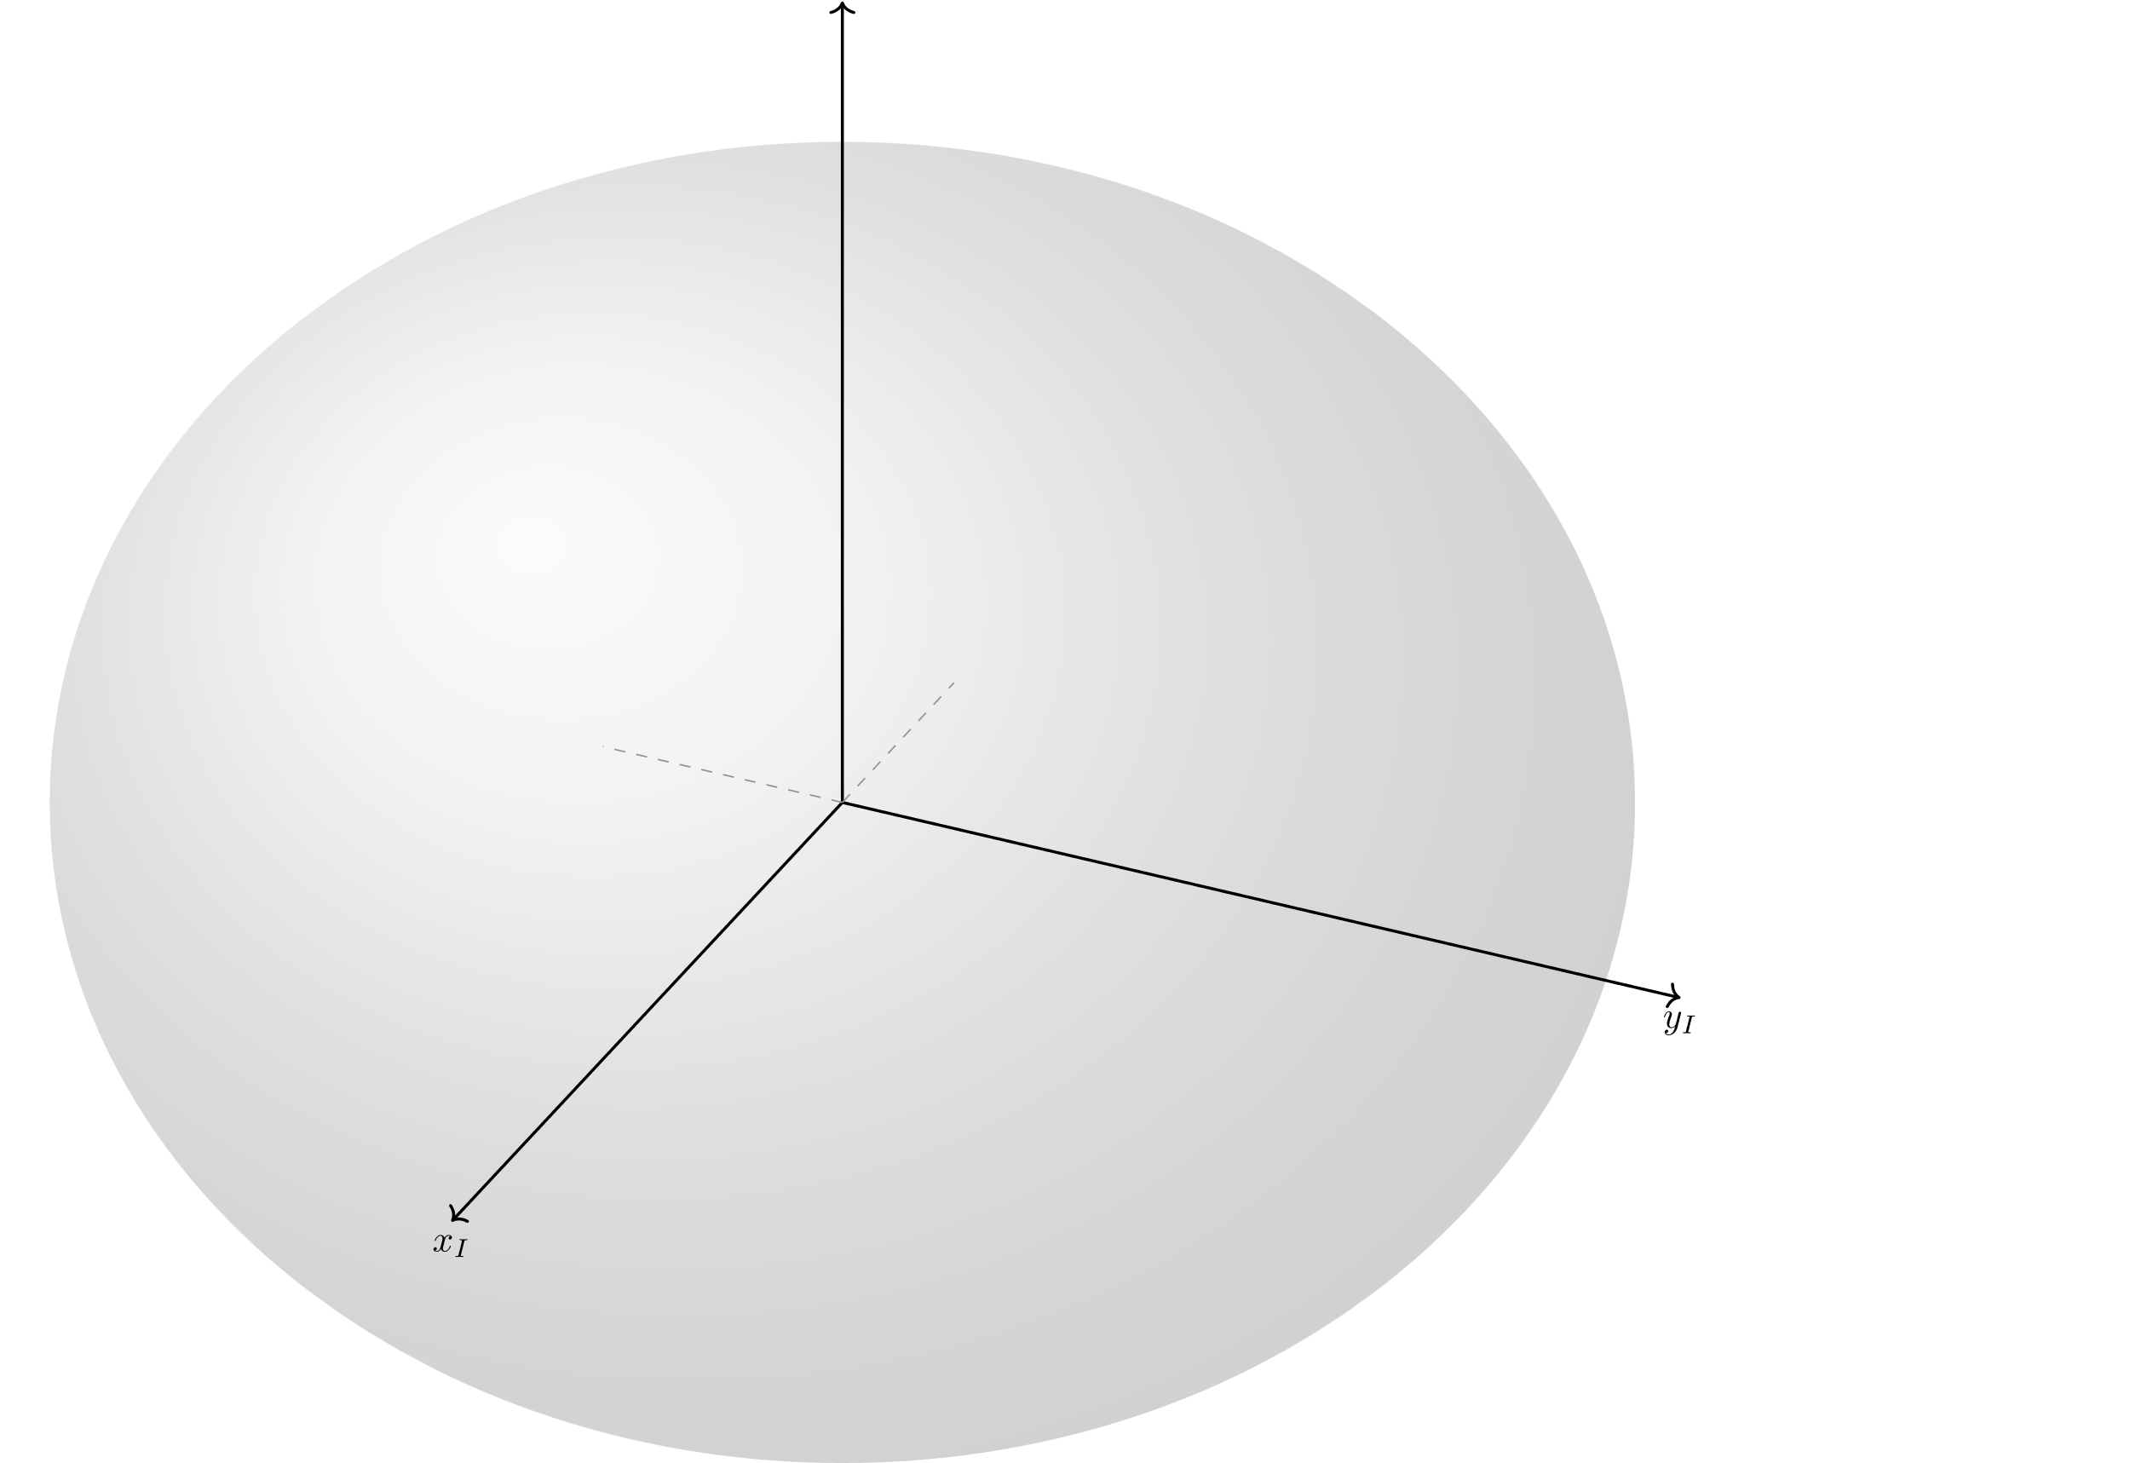
\tdplotsetmaincoords{60}{115} % controls the orientation of the main coordinate system (Inertial Frame)
\pgfplotsset{compat=newest}
\begin{tikzpicture}[tdplot_main_coords, scale = 2.5]
% Create a point (P)
\coordinate (P) at (3,3,3);
% Origin
\coordinate (O) at (0,0,0);
% Define the ellipsoid parameters
\def\rx{3cm} % x-radius
\def\ry{2.5cm} % y-radius
% Draw shaded circle
\shade[ball color = lightgray,
opacity = 0.25] (0,0,0) ellipse ({\rx} and {\ry});
% Inertial Frame {x_I,y_I,z_I}
\draw[thick,->] (0,0,0) -- (3.5,0,0) node[anchor=north]{$x_I$};
\draw[thick,->] (0,0,0) -- (0,3.5,0) node[anchor=north]{$y_I$};
\draw[thick,->] (0,0,0) -- (0,0,3.5);
\draw[dashed, gray] (0,0,0) -- (-1,0,0);
\draw[dashed, gray] (0,0,0) -- (0,-1,0);
\end{tikzpicture}

Slide 29
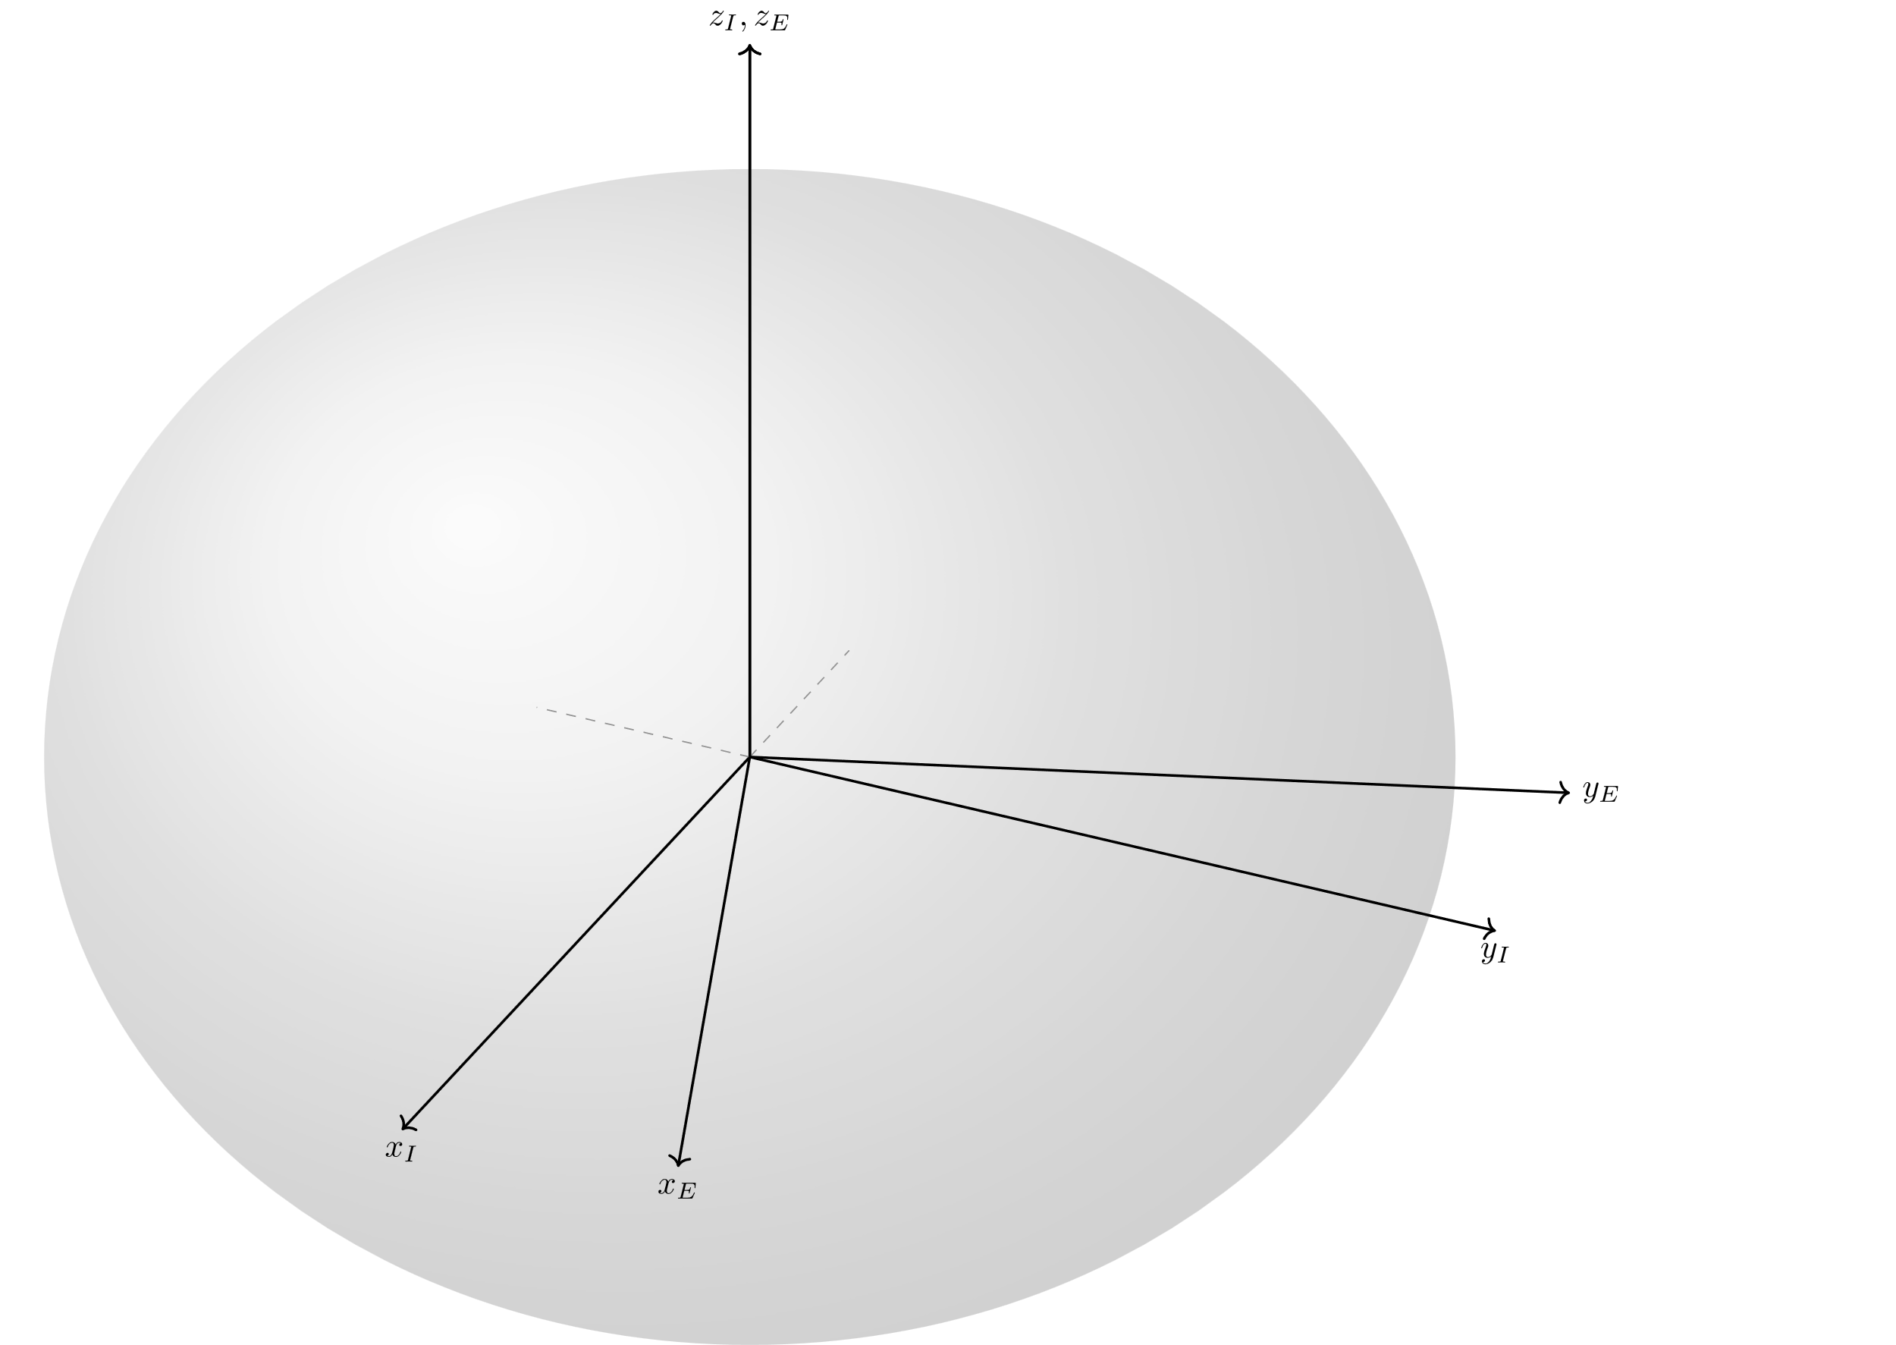
\tdplotsetmaincoords{60}{115} % controls the orientation of the main coordinate system (Inertial Frame)
\pgfplotsset{compat=newest}
\begin{tikzpicture}[tdplot_main_coords, scale = 2.5]
% Create a point (P)
\coordinate (P) at (3,3,3);
% Origin
\coordinate (O) at (0,0,0);
% Define the ellipsoid parameters
\def\rx{3cm} % x-radius
\def\ry{2.5cm} % y-radius
% Draw shaded circle
\shade[ball color = lightgray,
opacity = 0.25] (0,0,0) ellipse ({\rx} and {\ry});
% Inertial Frame {x_I,y_I,z_I}
\draw[thick,->] (0,0,0) -- (3.5,0,0) node[anchor=north]{$x_I$};
\draw[thick,->] (0,0,0) -- (0,3.5,0) node[anchor=north]{$y_I$};
\draw[thick,->] (0,0,0) -- (0,0,3.5);
\draw[dashed, gray] (0,0,0) -- (-1,0,0);
\draw[dashed, gray] (0,0,0) -- (0,-1,0);
% Earth Frame {x_E,y_E,z_E}
\tdplotsetrotatedcoords{20}{0}{0} % Earth frame orientation
\draw[thick,tdplot_rotated_coords,->] (0,0,0) --
(3.5,0,0) node[anchor=north]{$x_E$};
\draw[thick,tdplot_rotated_coords,->] (0,0,0) --
(0,3.5,0) node[anchor=west]{$y_E$};
\draw[thick,tdplot_rotated_coords,->] (0,0,0) --
(0,0,3.5) node[anchor=south]{$z_I,z_E$};
\end{tikzpicture}
\tdplotsetrotatedcoords{rot. About Z}{rot. About Y}{rot. About Y}, {X,Y,Z} of the main coord. system

Slide 30
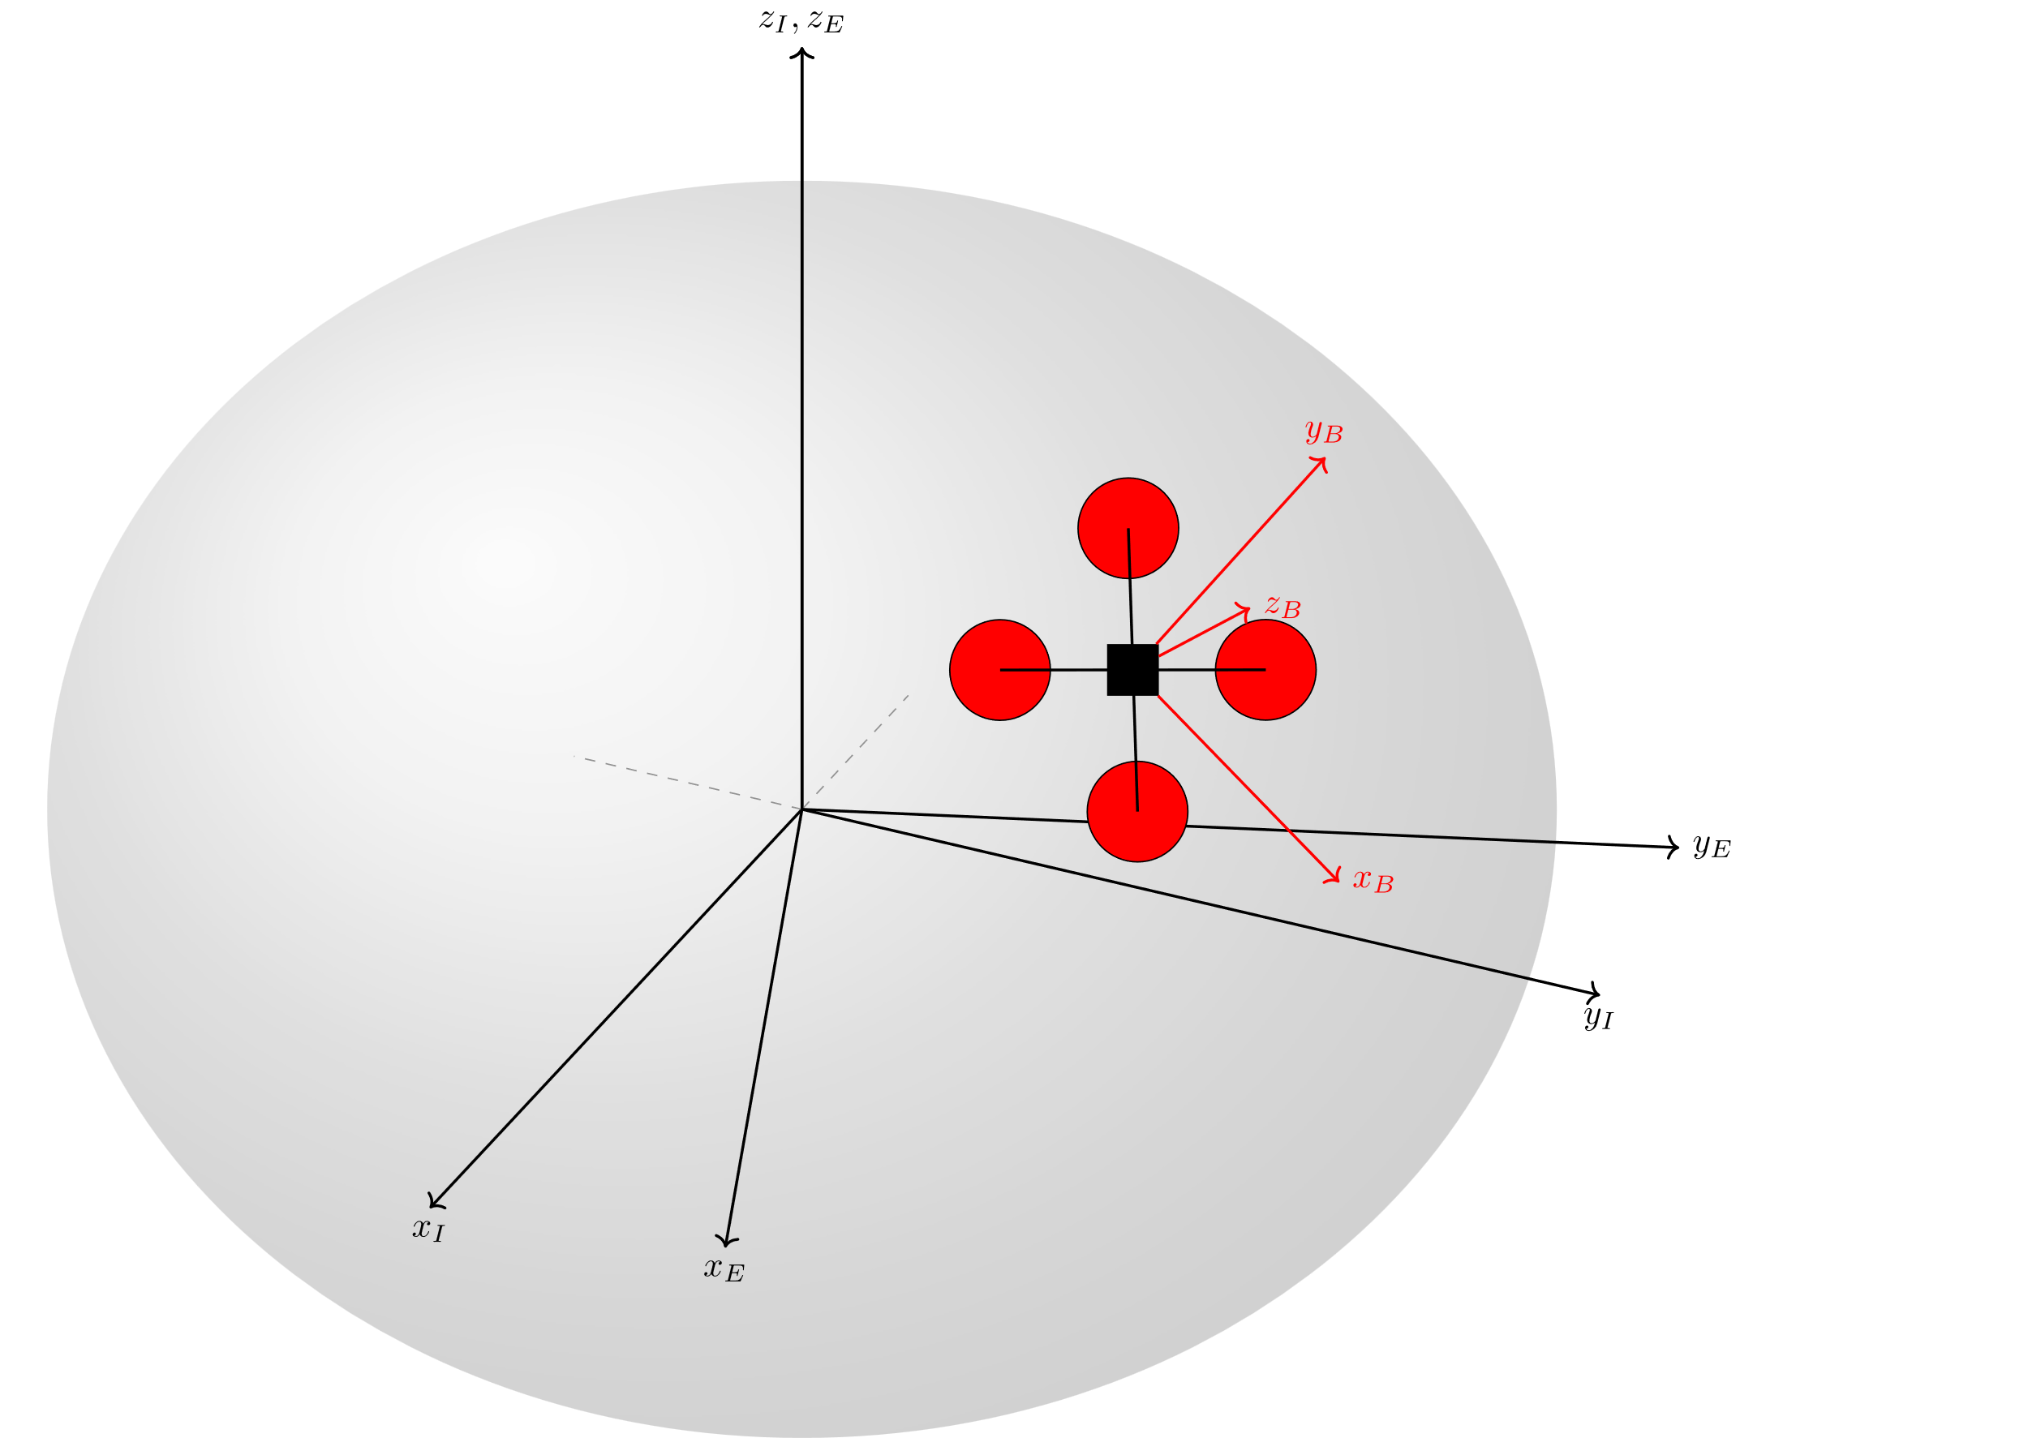

\tdplotsetmaincoords{60}{115} % controls the orientation of the main coordinate system (Inertial Frame)
\pgfplotsset{compat=newest}
\begin{tikzpicture}[tdplot_main_coords, scale = 2.5]
% Create a point (P)
\coordinate (P) at (3,3,3);
% Previous Code hidden
% Quadcopter graphic
\tdplotsetrotatedcoords{100}{45}{40} % Rotation of the quadcopter wrt the main coordinate system
\tdplotsetrotatedcoordsorigin{(P)} % P is the origin of the rotated coordinate system
\node[tdplot_rotated_coords]{
\input{quadCopter}};
\end{tikzpicture}
quadCopter.tex

Slide 31
\usepackage{tikz}
\usepackage{tikz-3dplot}
tikz-3dplot Documentation
Source
./illustrationScripts/FavExamples/ referenceFrames_standalone.tex

Slide 32
For the MATLAB Enjoyers:
matlab2tikz

Slide 33
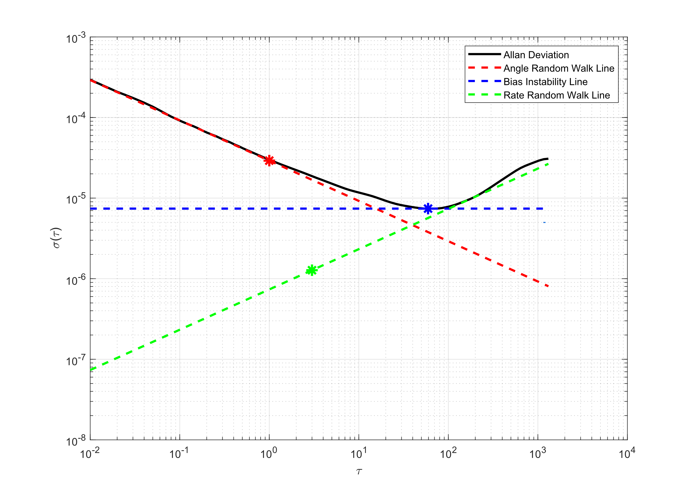
MATLAB Figure
matlab2tikz:
Repository (Matlab Central)
\usepackage{tikz}
\usepackage{pgfplots}
FavExamples/matlab_TikZ/noiseAnalysis.m:
addpath(„<path to matlab2tikz src>“)
********* Code Body *********
figure;
<Figure Code>
cleanfigure;
matlab2tikz(„fileName.tex“) % after figure generation
make sure that the src folder for matlab2tikz is in the MATLAB Path !!

Slide 34
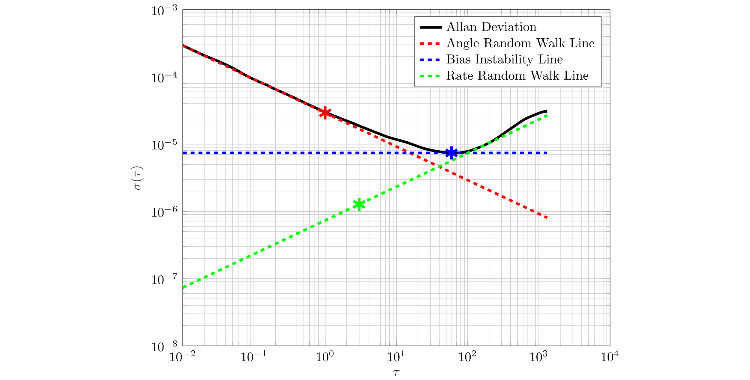
TikZ Figure
FavExamples/matlab_TikZ/allanVar_standalone.tex:
\documentclass[preview]{standalone}
\input{packages}
\pgfplotsset{compat=newest} % Optional
\begin{document}
\begin{figure}
\centering
\scalebox{0.75}[0.75]{\input{allanVar.tex}}
\end{figure}
\end{document}
> help matlab2tikz; % for more customizations
make sure that the src folder for matlab2tikz is in the MATLAB Path
Something similar for other programming languages (eg. Python)?
Source
./illustrationScripts/FavExamples/allanVar_standalone.tex

Slide 35
Some helpful links

Slide 36
Some helpful links
TikZ official documentation: https://tikz.dev/
Website repository of TikZ diagrams: https://tikz.net/
TikZ documentation (Overleaf): https://www.overleaf.com/learn/latex/TikZ_package
Github Repository consisting of numerous TikZ examples: https://github.com/f0nzie/tikz_favorites
matlab2tikz: https://de.mathworks.com/matlabcentral/fileexchange/22022-matlab2tikz-matlab2tikz
tikz-3dplot: https://ctan.math.washington.edu/tex-archive/graphics/pgf/contrib/tikz-3dplot/tikz-3dplot_documentation.pdf

Slide 37
Some suggestions

Slide 38
TikZ is not the most fast or efficient solution; but it will definitely give the most beautiful and professional looking scientific figures. It guarantees a lot of pain, but also makes your scientific figures great again.

Slide 39
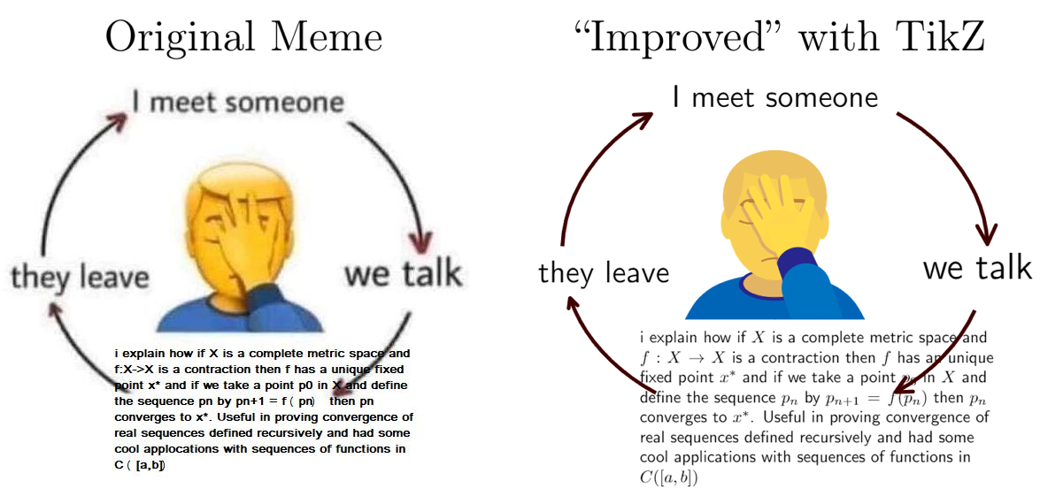

Slide 40
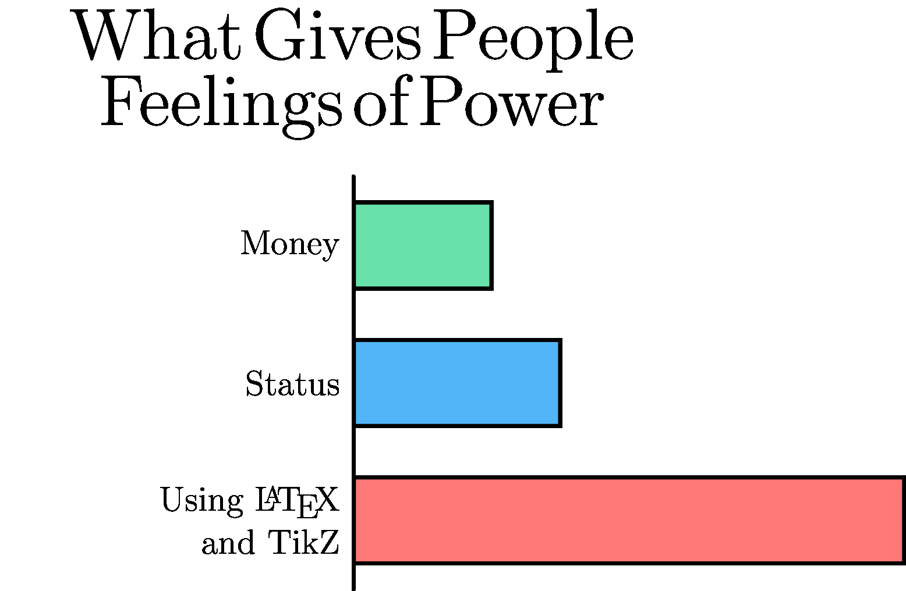

Slide 41

Open Discussion
What software do you use for vector graphic generation?
How does your workflow for scientific documentation look like?
Any additional suggestions/recommendations/tips for TikZ
Github Repository for all the material presented

